Slide 1

The Game of Life
Conway and Nature
architrino.com

Slide 2
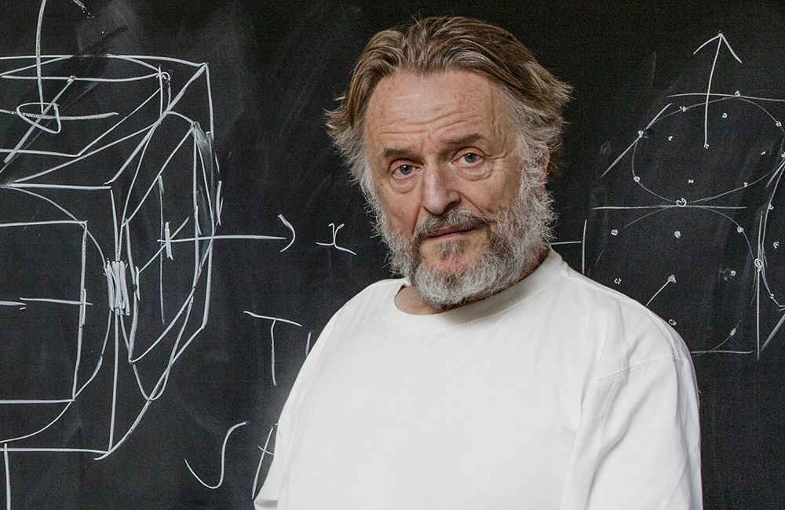
The Game of Life is a cellular automaton devised by the British mathematician John Horton Conway in 1970.
John Horton Conway FRS (26 December 1937 – 11 April 2020)
architrino.com

Slide 3
Universe
Rules
Grid
Initial State — 0
Evolution — 1
Evolution — N
Conway’s Game of Life Universe
Classically, the Game of Life plays out in an infinite, two-dimensional orthogonal grid of square cells.
Each cell is in one of two possible states, live or dead.
One meta player interacts by creating an initial configuration
Time moves forward only in discrete time steps.
The evolution is determined by the initial grid state, requiring no further input.
Meta player(s) may passively observe the initial configuration and how the grid evolves.
architrino.com

Slide 4
Universe
Rules
Grid
Initial State — 0
Evolution — 1
Evolution — 2
Conway’s Game of Life Rules
Every cell interacts with its eight surrounding neighbors.
At each time step, the following transitions occur:
Any live cell with fewer than two live neighbors dies, as if by underpopulation.
Any live cell with two or three live neighbors lives on to the next evolution step.
Any live cell with more than three live neighbors dies, as if by overpopulation.
Any dead cell with exactly three live neighbors becomes a live cell, as if by reproduction.
The first evolution step is created by applying the rules to every cell in the initial grid.
The rules are applied each time step to create a new evolution step.
architrino.com

Slide 5
Conway’s Cell Life State Diagram
{0,1,2, 4,5,6,7,8}
{2,3}
dead
live
{3}
{0,1, 4,5,6,7,8}
architrino.com

Slide 6
The Glider
Grid
Initial State — 0
Evolution — 1
Evolution — 2
Evolution — 3
Evolution — 4
Evolution — 5
Evolution — 6
architrino.com

Slide 7
Aspects of Conway’s Game of Life
Consider each glider as an assembly-like pattern of live cells.
The glider appears to live on as it moves across an empty grid.
The cells are temporary; most last only a few time steps.
The pattern keeps its identity while the cells turn over.
In Conway's Life, provenance means a live cell exists at one grid location for one tick, many ticks, or forever.
architrino.com

Slide 8
The Glider with Evolutionary Step Lineage
Grid
Initial State — 0
Evolution — 1
Evolution — 2
 |  | 0
 |  |  | 0
 | 0 | 0 | 0
 | 1 |  | 0
 |  | 0 | 0
 |  | 1
 |  |  | 0
 | 2 |  | 0
 |  | 1 | 2
Evolution — 3
Evolution — 4
Evolution — 5
Evolution — 6
 |  | 3
 |  |  | 0 | 3
 |  | 1 | 2
 |  |  | 4
 |  |  |  | 3
 |  | 1 | 2 | 4
 |  | 5 |  | 3
 |  |  | 2 | 4
 |  |  | 5
 |  |  |  | 3
 |  | 6 |  | 4
 |  |  | 5 | 6
architrino.com

Slide 9
A Gosper's glider gun creating gliders
Wikipedia
architrino.com

Slide 10
The Game of Life on the surface of a toroidal trefoil knot Wikipedia
architrino.com

Slide 11
Game of Life is only an analogy
Question | Conway's Game of Life | AAA master equation
What changes? | Cell states switch between live and dead. | Architrino paths evolve continuously.
Time | The grid updates one tick at a time. | Time changes continuously, not in ticks.
Rule | A local neighbor rule chooses the next state. | An action law selects the allowed path history.
Origin | A meta player chooses an initial pattern. | Architrinos are persistent primitives, not cells born from a grid.
What survives? | Patterns such as gliders can persist while their cells turn over. | Assemblies can persist while architrinos keep continuous provenance.
Lesson | Simple rules can produce surprising structure. | The analogy helps intuition, but AAA is not a cellular automaton.
architrino.com

